Slide 1

Youtube comments analysis
MENTOR : Mr. Rajshekhar & MS. Pallavi
TEAM MEMBERS (GROUP 3):
Mr. Rupesh Vilas Ravate
Mr. Zaheen Mahaey
Miss. Anjali Chawda
Mr. Sai Praneeth Chiliveru
Mrs. Sowmya Sandeep
Mr. Suprith C S
Mr. Jeevan Kumar G T

Slide 2
BUSINESS OBJECTIVE
The objective of the project is to analyse the comments of a youtube video.
Take the search keyword as an input.
List down the top 10 search results.
Then list out all the results based on maximum number of view per video in ascending order.
Scrape the comments of the top video.
Translate all comments to English.
Perform analysis on the comments.

Slide 3
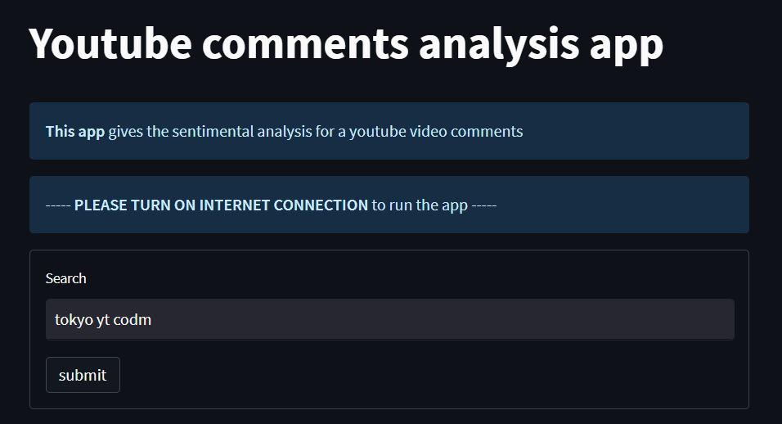
PROJECT PIPELINE: Enter key word
User need to enter the keyword in the search bar and click the submit button as shown below.

Slide 4
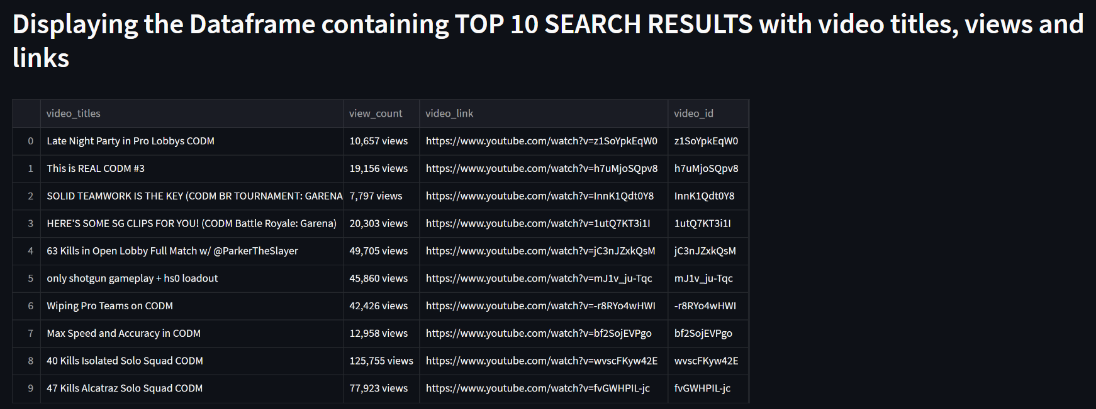
PROJECT PIPELINE: Dataset of top 10 search results
The dataset containing all the top 10 search results are displayed with video title, URL, view count per video and video ID.

Slide 5
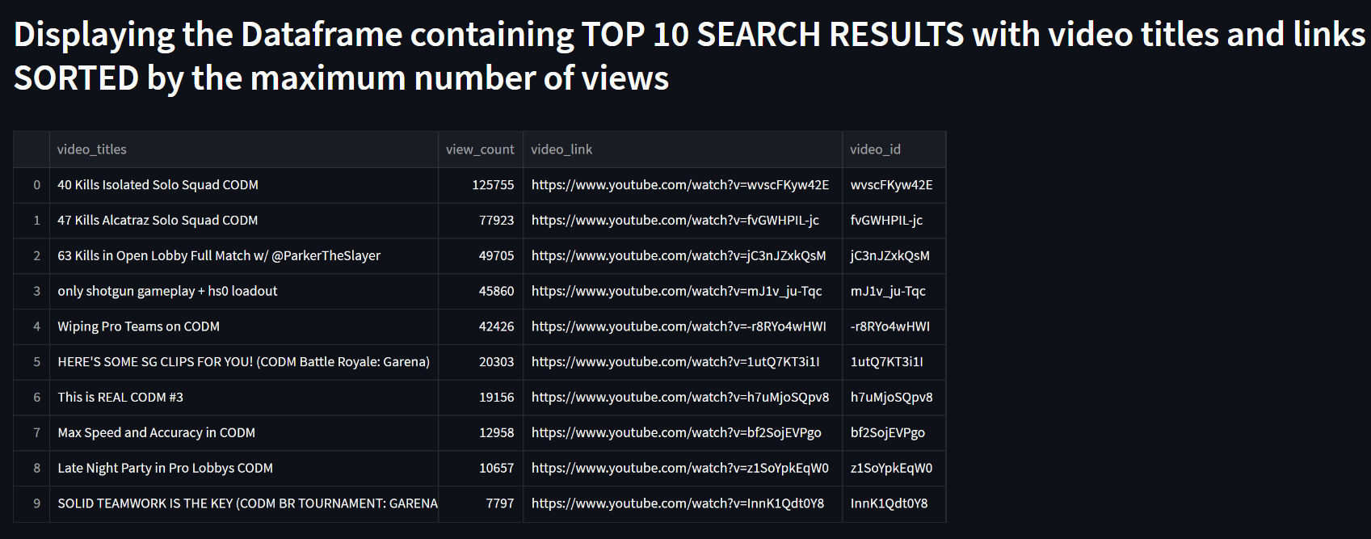
PROJECT PIPELINE:Dataset sorted based on max number of views
The dataset containing all the top 10 search results is sorted by the video with maximum number of views at the top.

Slide 6
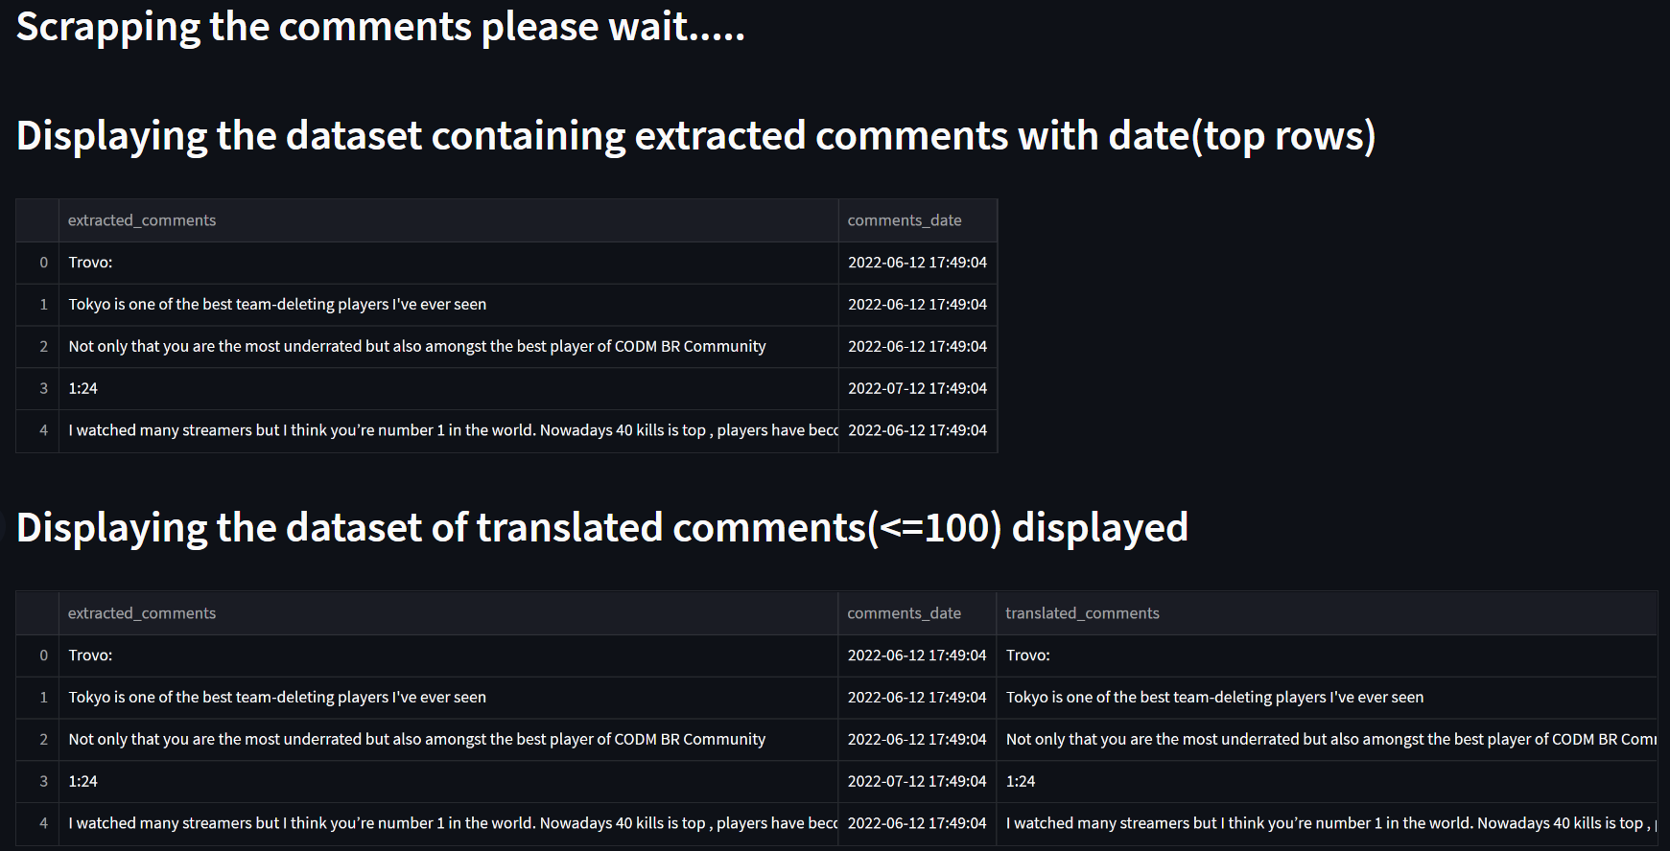
PROJECT PIPELINE:Datasets with extracted comments and translated comments with date
Then the comments of the video with max views are extracted and translated into English and stored in a dataset under translated comments column.

Slide 7
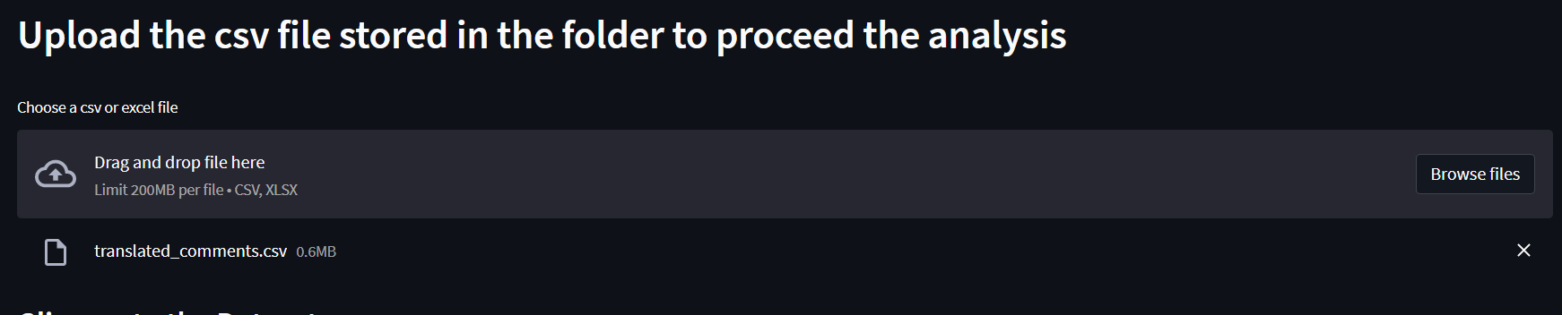
PROJECT PIPELINE:Importing a CSV file
Then the dataset containing features extracted, translated and comments date is stored in a csv file by the name translated_comments then is imported for analysis.

Slide 8
Exploratory Data Analysis

Slide 9
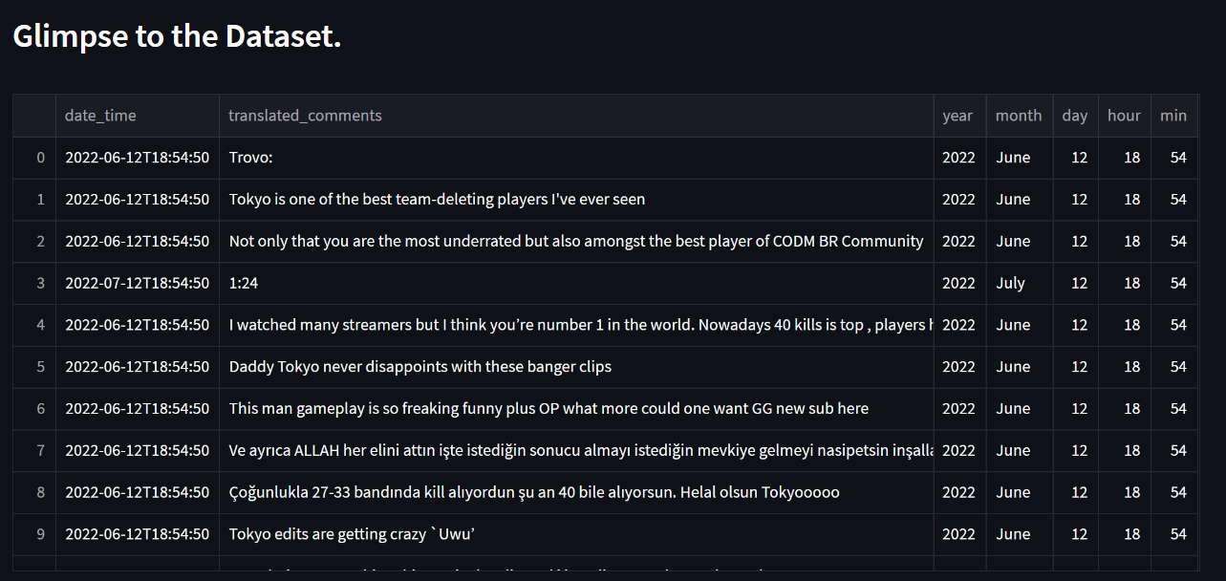
PROJECT PIPELINE:Data preprocessing
Then the year, month, days, mins, hours of the comments are extracted from comments date_time column and stored in the columns with their respective column names.

Slide 10
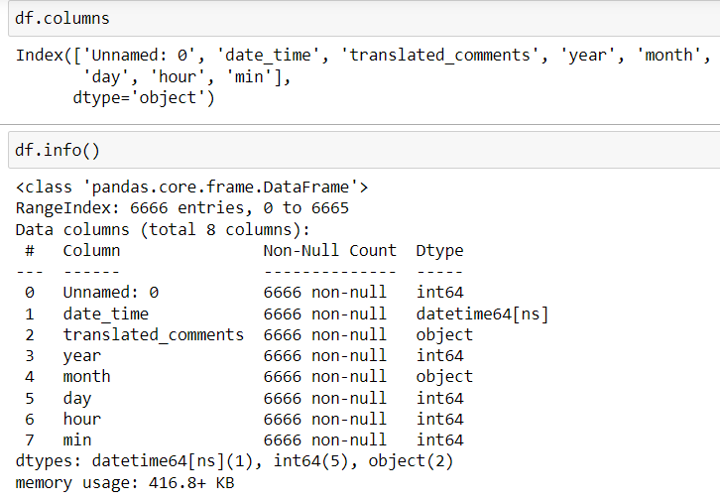
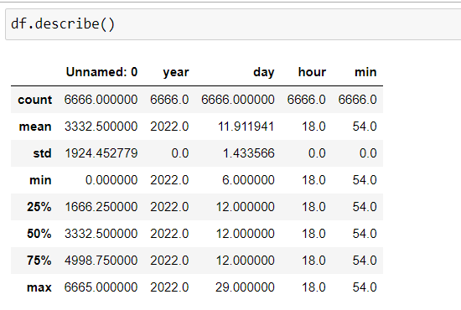
Data set details

Slide 11
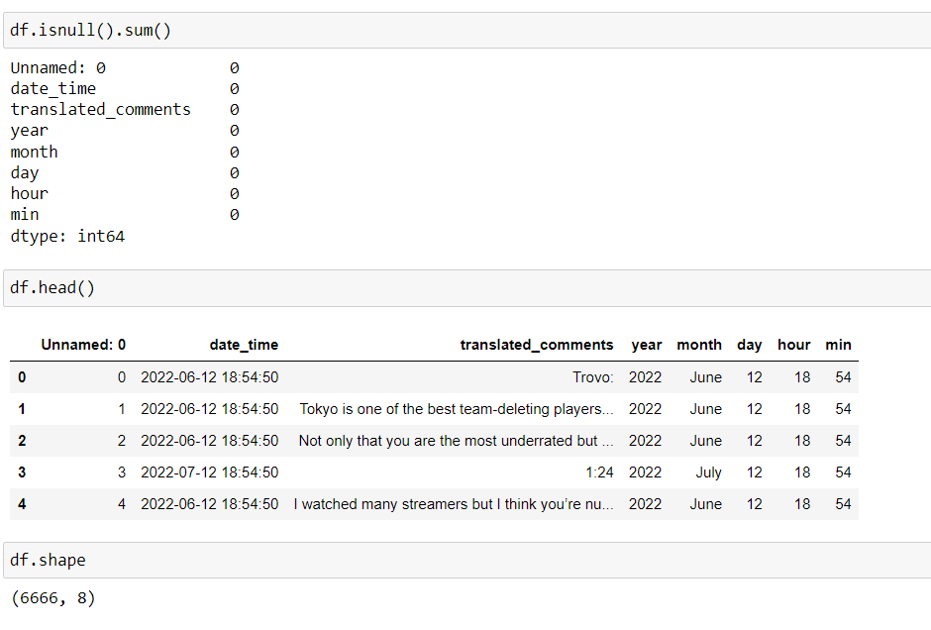
Top 5 rows of the dataset are shown below.
Shape of the dataset is also displayed.
As seen below there are ZERO null entry values.

Slide 12
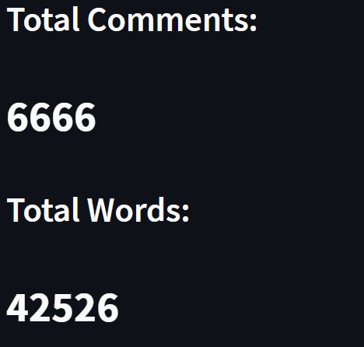
PROJECT PIPELINE:Total comments with word count
Total comments and total words are displayed.

Slide 13
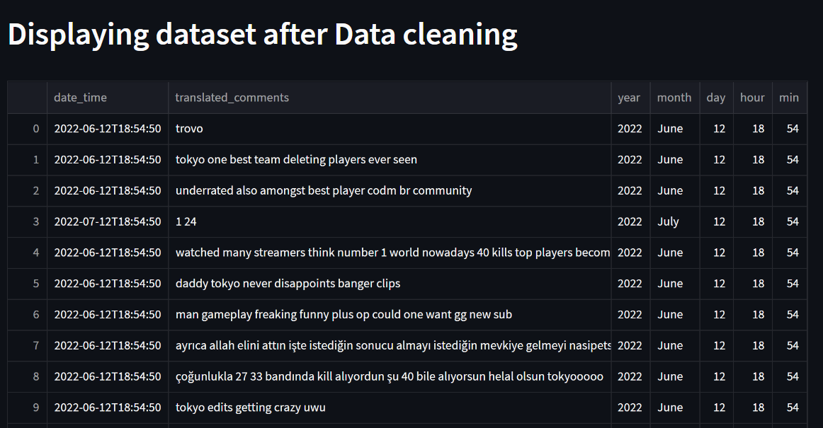
PROJECT PIPELINE:Dataset after data cleaning
Dataset after date pre-processing is displayed.
Unwanted punctuations, stop words, links, special characters are removed and each text is converted to lower case.

Slide 14
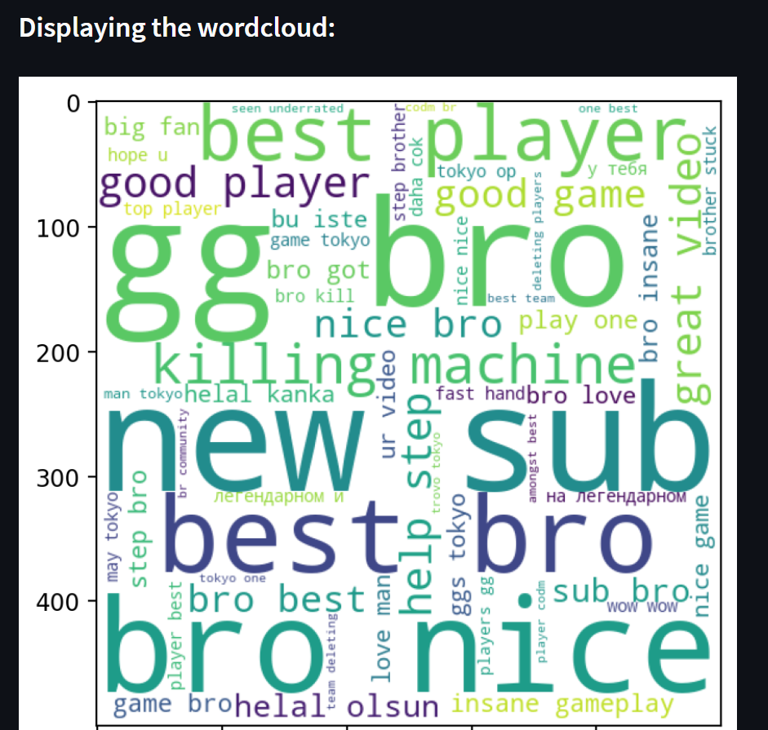
PROJECT PIPELINE:Word cloud
Word cloud with the words more frequently used is displayed.

Slide 15
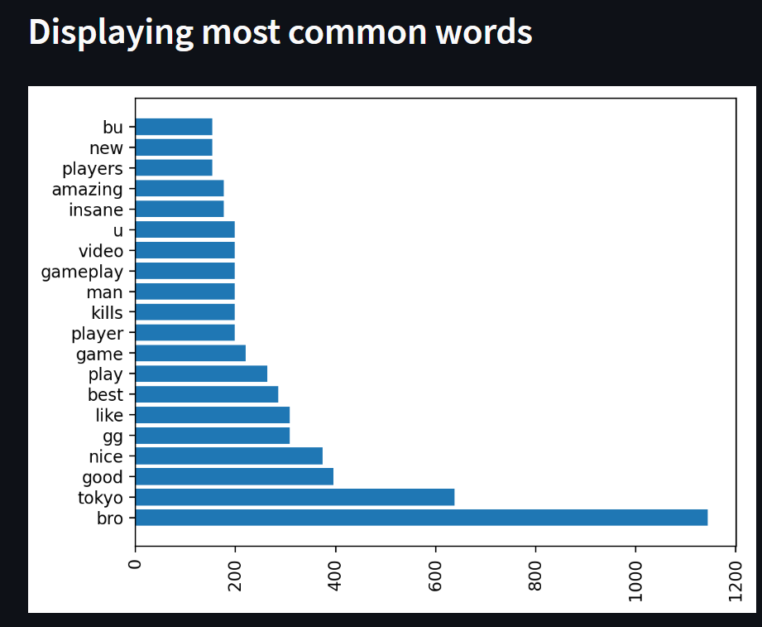
PROJECT PIPELINE:Most common words in comment section
The most common words that are most frequently used are displayed with their count.

Slide 16
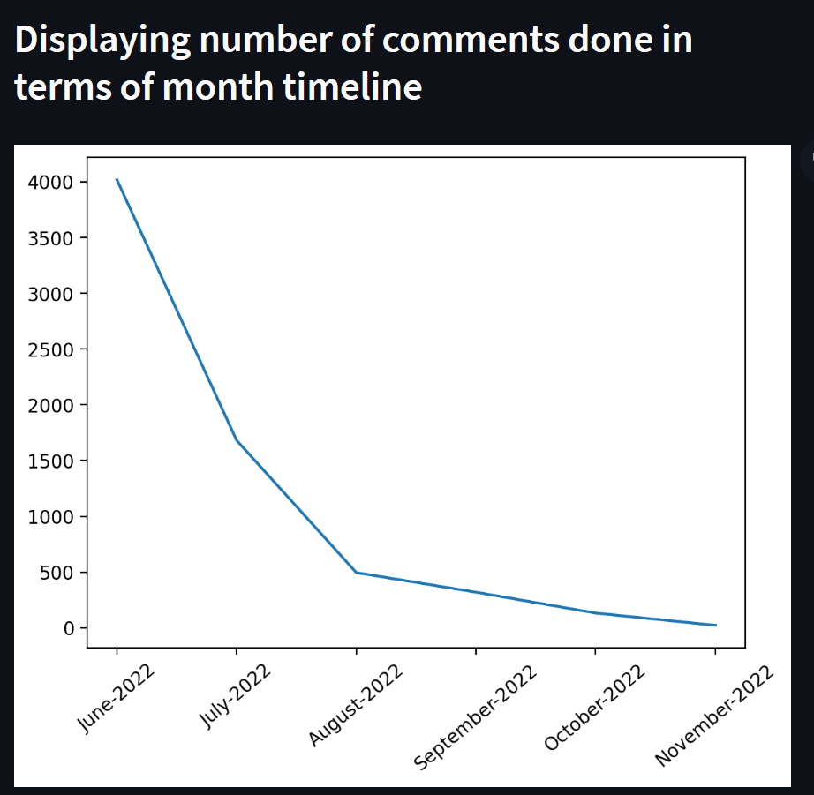
PROJECT PIPELINE:Comments count done as per month timeline
The figure represents the total number of comments that are done and separated by month timeline.
As the graph shows the rate of comments done decreases over a period of months time line.

Slide 17
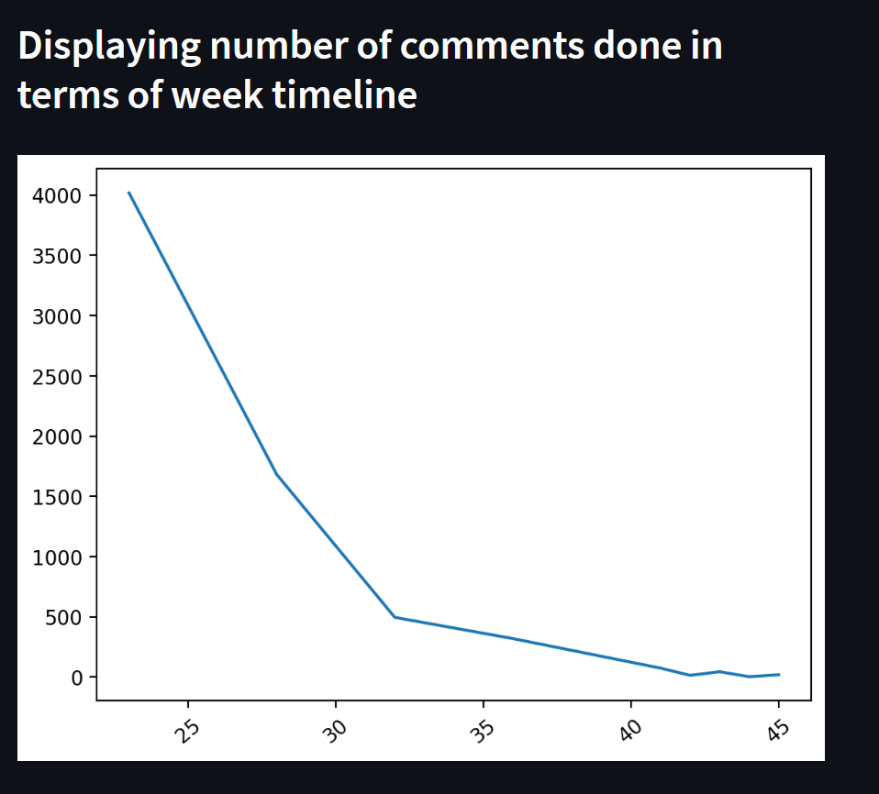
PROJECT PIPELINE:Comments count done as per week timeline
The figure represents the total number of comments that are done and separated by weekly timeline.
As the graph shows the rate of comments done decreases over a period of weekly time line.

Slide 18
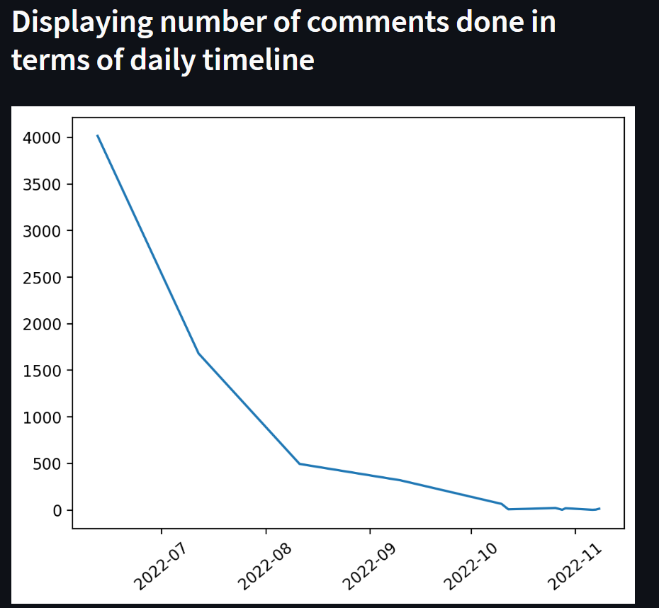
PROJECT PIPELINE: Comments count done as per daily timeline
The figure represents the total number of comments that are done and separated by daily timeline.
As the graph shows the rate of comments done decreases over a period of daily time line.

Slide 19
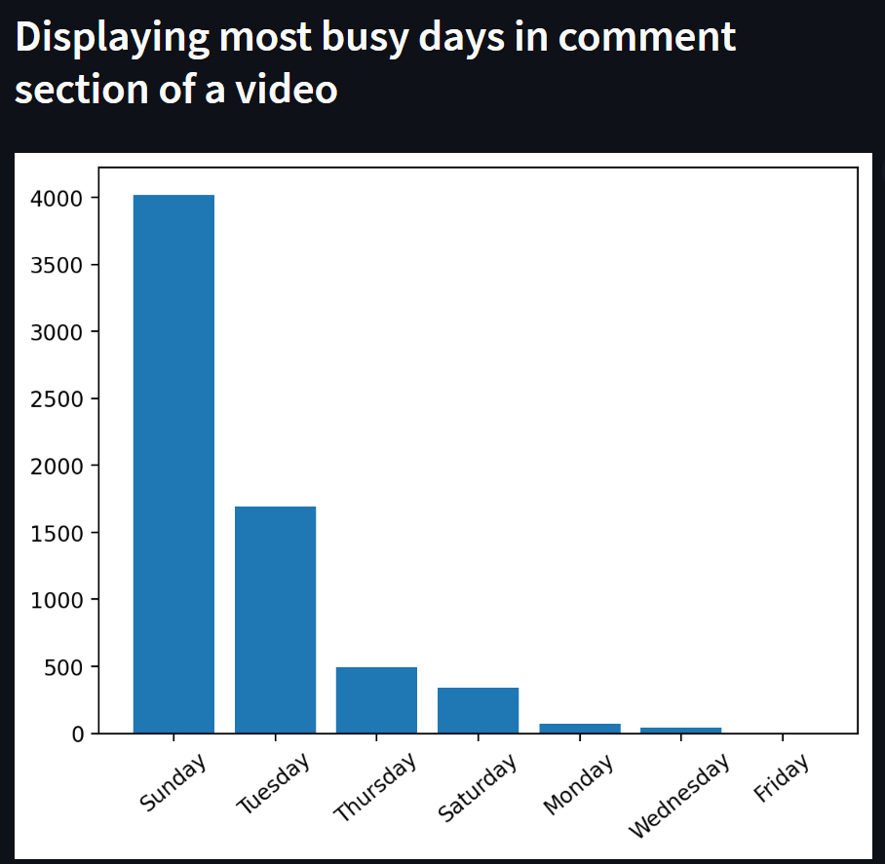
PROJECT PIPELINE: Most busy days in the comment section
The figure represents the most busy days in the comment section in a week.
As the graph shows Sunday has the most active state in the comment section followed by Tuesday and so on.

Slide 20
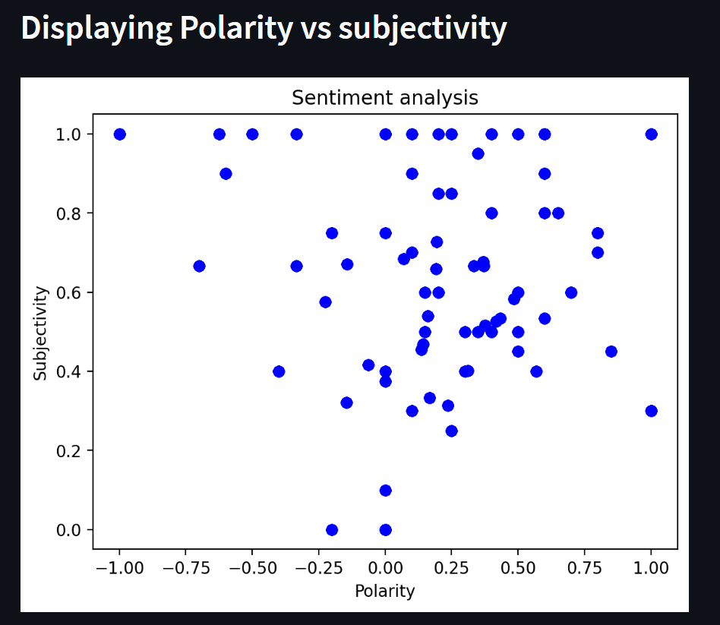
PROJECT PIPELINE:Polarity vs Subjectivity
The figure represents the polarity vs subjectivity of the comments.
As the graph shows most of the comments have a polarity greater than 0 and subjectivity greater than 0.4.

Slide 21
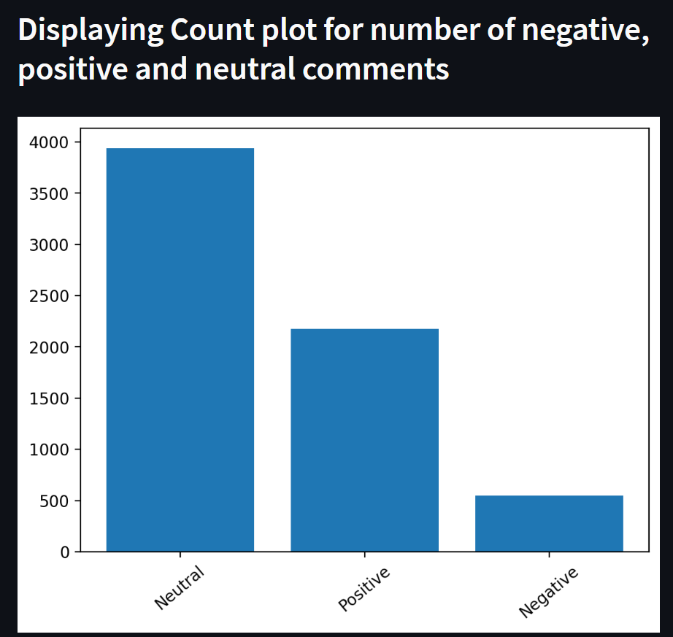
PROJECT PIPELINE: Countplot of categorised comments
The figure represents frequency of negative, positive and neutral comments.
As the graph shows most of the comments are neutral followed by positive and negative comments.

Slide 22
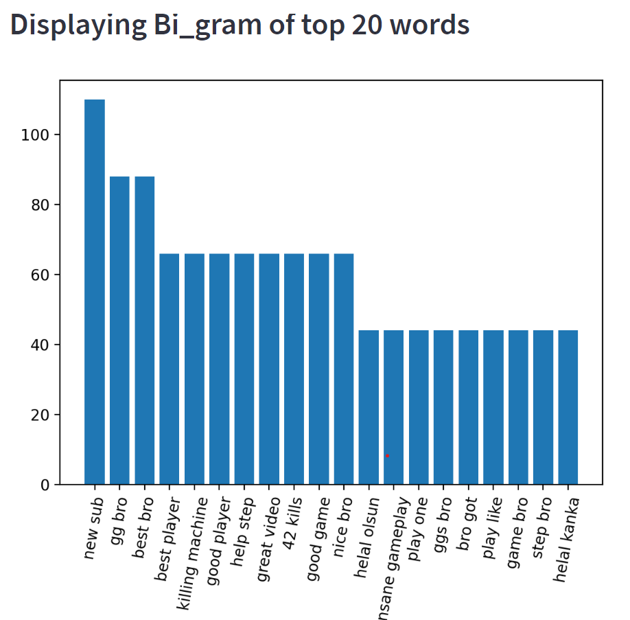
PROJECT PIPELINE:Bi-gram
The figure represents bi-gram of top 20 words that are more frequently used in pair.

Slide 23
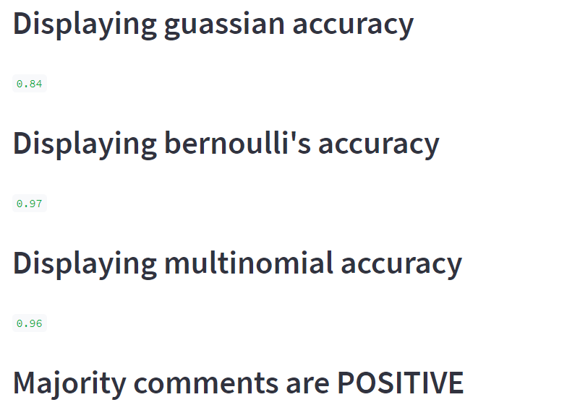
PROJECT PIPELINE : Model building
The model is built using naive bayes classifier using Guassian NB, Bernoulli’s NB, Multi-nominal NB.
The respective accuracies are shown.
The majority comments are POSITIVE as compared to NEGATIVE

Slide 24
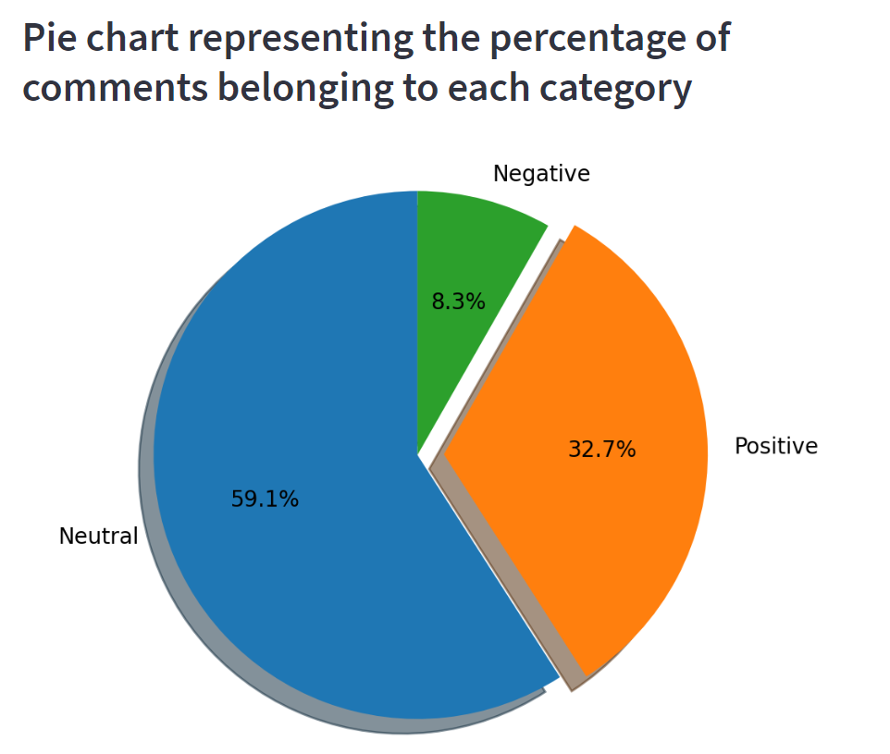
PROJECT PIPELINE : Pie chart
The pie chart represents the percentage comments categorised into positive, negative and neutral.
This pie chart contains respective category percentages as shown.
The majority percentage belongs to NEUTRAL category followed by POSITIVE and NEGATIVE.

Slide 25
THANK YOU

